Slide 2
Inductive Bible
Study Method

Slide 3
Welcome back to IBSM
Bite 04

Slide 4


Slide 5
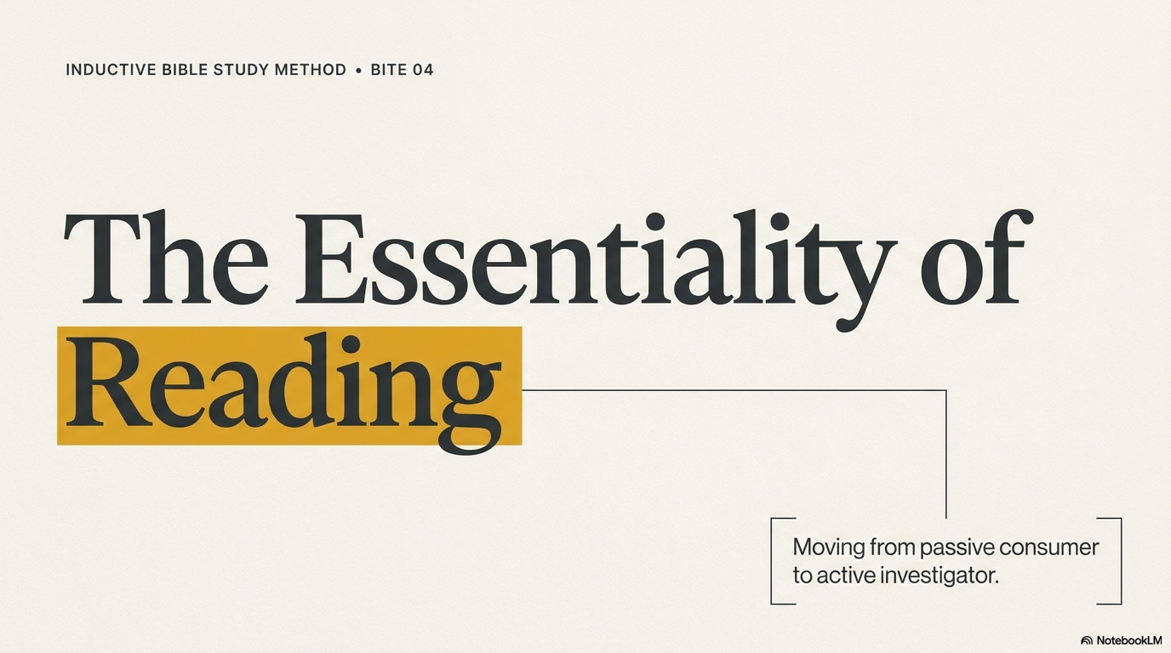

Slide 6
Essentiality of Reading
Learn to read BETTER and FASTER
Learn to read as for the FIRST time
Learn to read it as a love letter

Slide 7
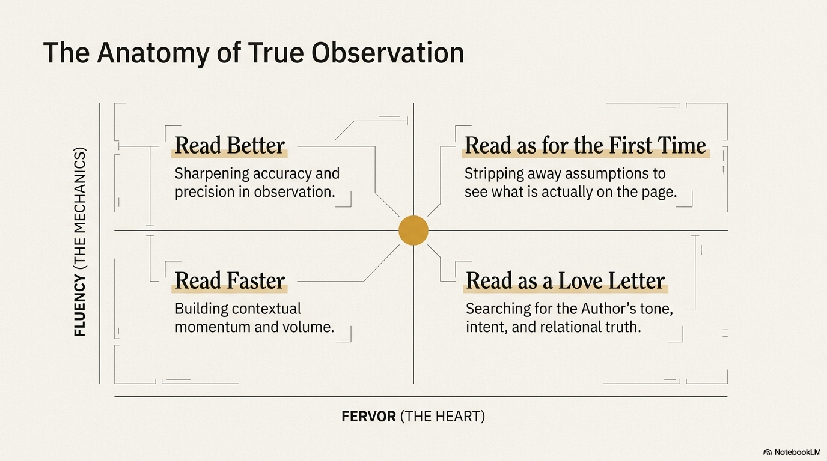

Slide 8
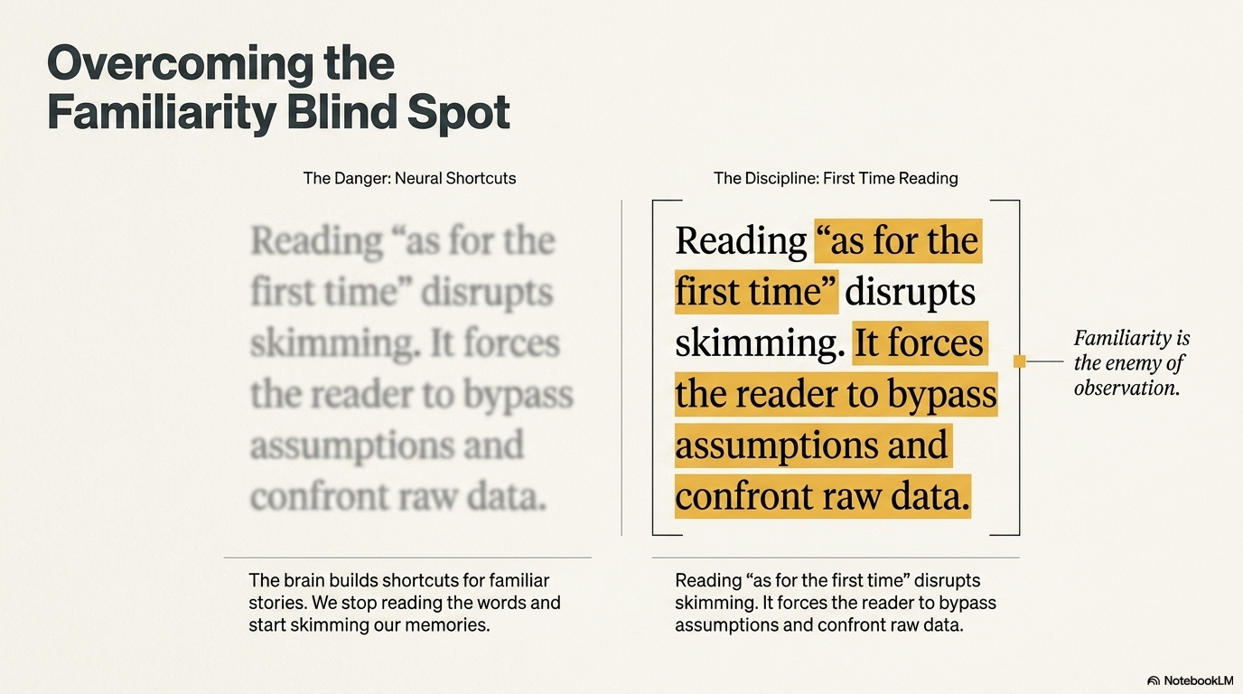

Slide 9
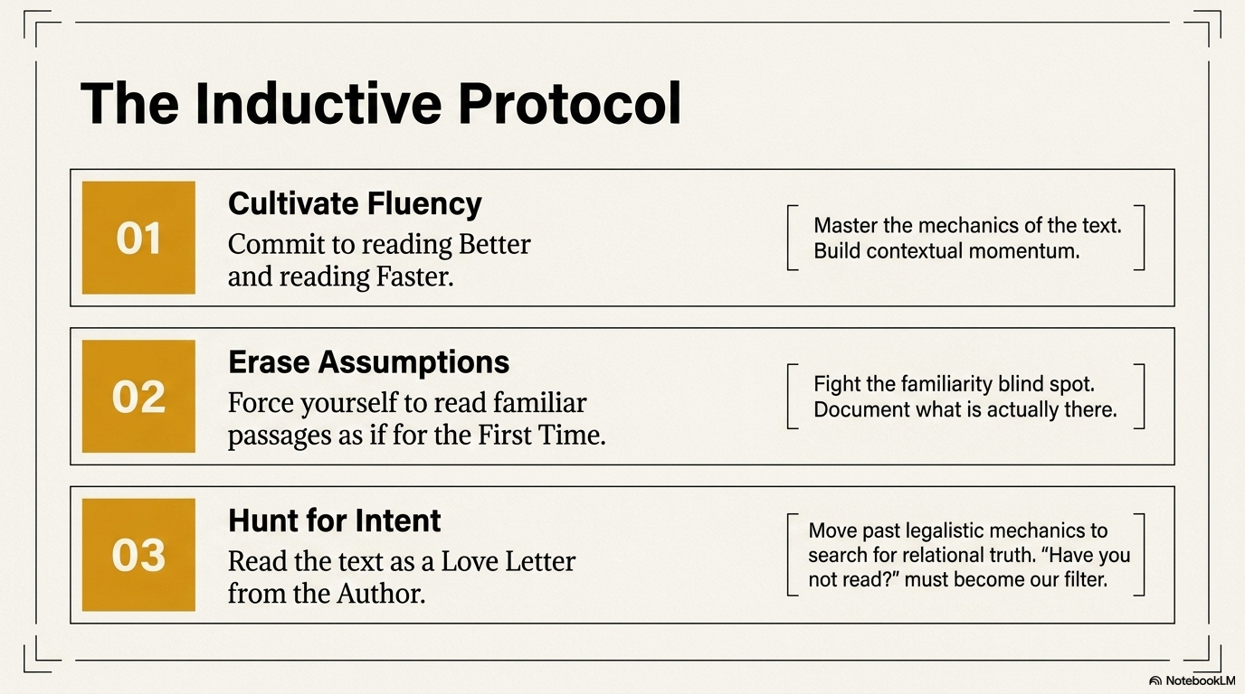

Slide 10
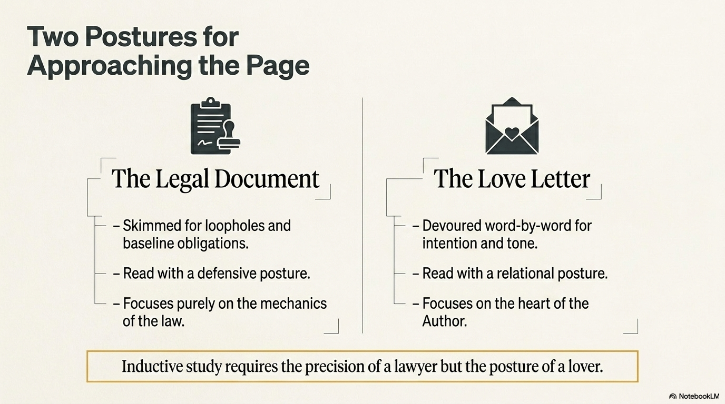

Slide 11
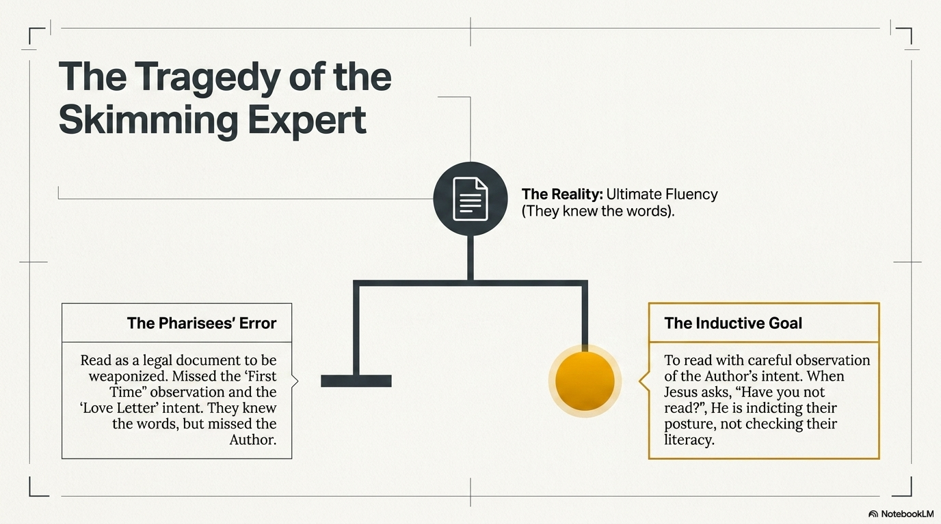

Slide 12
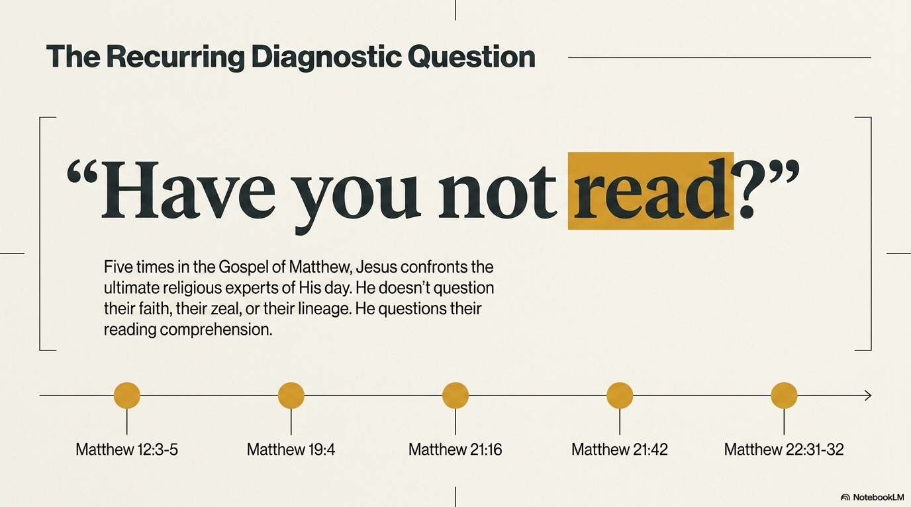

Slide 13

The Essentiality of Reading
3 But He said to them, “Have you not read what David did, when he became hungry, he and his companions; how
he entered the house of God, and they ate the consecrated bread, which was not lawful for him to eat, nor for those with him, but for the priests alone? Or have you not read in the Law, that on the Sabbath the priests in the temple break the Sabbath, and are innocent?”
Matthew 12:3-5

Slide 14
The Essentiality of Reading
And He answered and said, “Have you not read, that He who created them from the beginning made them male and female, . . .
Matthew 19:4

Slide 15
The Essentiality of Reading
And said to Him, “Do You hear what these are saying?” And Jesus said to them, “Yes; have you never read, ‘Out of the mouth of infants and nursing babes Thou hast prepared praise for Thyself’?”
Matthew 21:16

Slide 16
The Essentiality of Reading
Jesus said to them, “Did you never read in the Scriptures,
The stone which the builders rejected,
This became the chief corner stone;
This came about from the Lord,
And it is marvelous in our eyes?
Matthew 21:42

Slide 17
The Essentiality of Reading
“But regarding the resurrection of the dead, have you not read that which was spoken to you by God, saying, ‘I am the God of Abraham, and the God of Isaac, and the God of Jacob?’ He is not the God of the dead but of the living.”
Matthew 22:31-32

